Slide 1
MASTER OF TECHNOLOGY:
PHASE 2 PRESENTATION
[August 2011]
SE18 – Team 2S
Tran Ba Tien
Alvin Chang Parkk Khiong
Maung Tin Kyaw Oo
Roger Koh Ming Jin
Phyo Phyo Lwin
Junaith

Slide 2
Overview
Introduction
Use Case Modeling
Use Case Analysis
Software Architecture
Prototype Demo
Transition Strategy
Overall Project Progress
Management Problem
Implementation Phase Plan
Expected Implementation Issue

Slide 3
Introduction
Client:
  Name: Hoang Kim (Golden Gravure) Joint Stock Co.
  One of the leading providers of printing cylinders in Vietnam
What they have
    Around 80 Desktops
    Current system running on 1 server, running Win 2003, mysql database
    Current system (thick client) running on VB.NET
What they want
    To manage process / employee data (sales orders, cylinders, employee, roles, workflows)
    To generate reports for management (cylinder statistics, employee statistics)
    Real time system

Slide 4
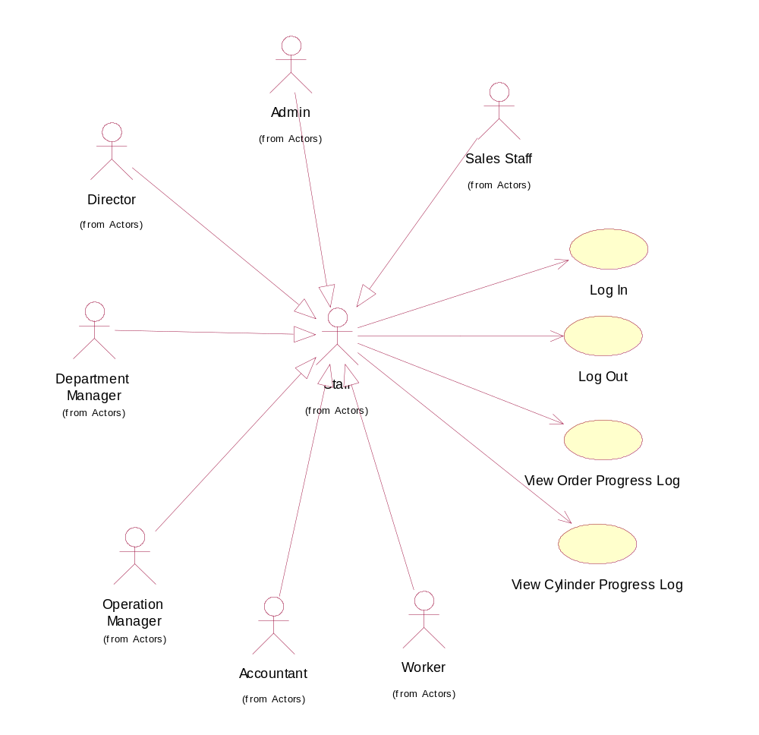
Use Case Modeling

Slide 5
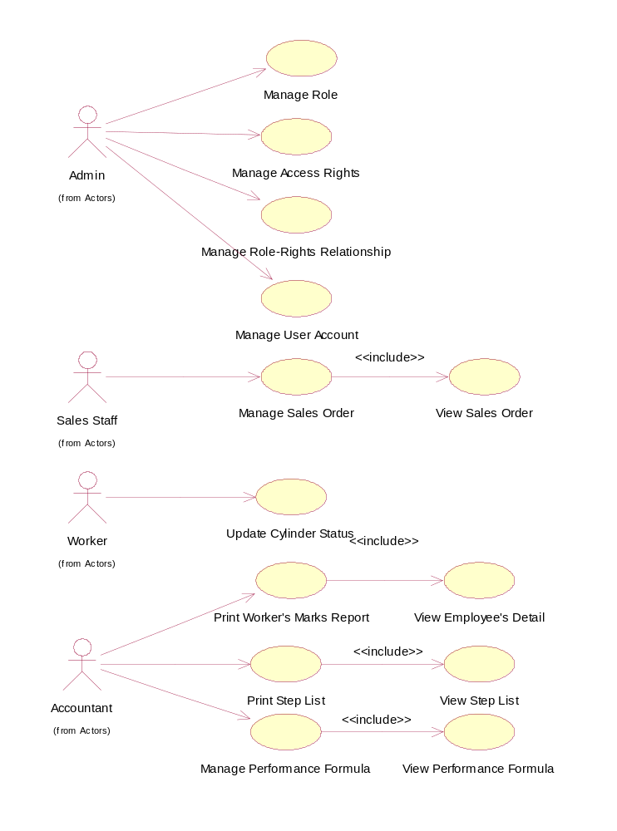
Use Case Modeling (2)

Slide 6
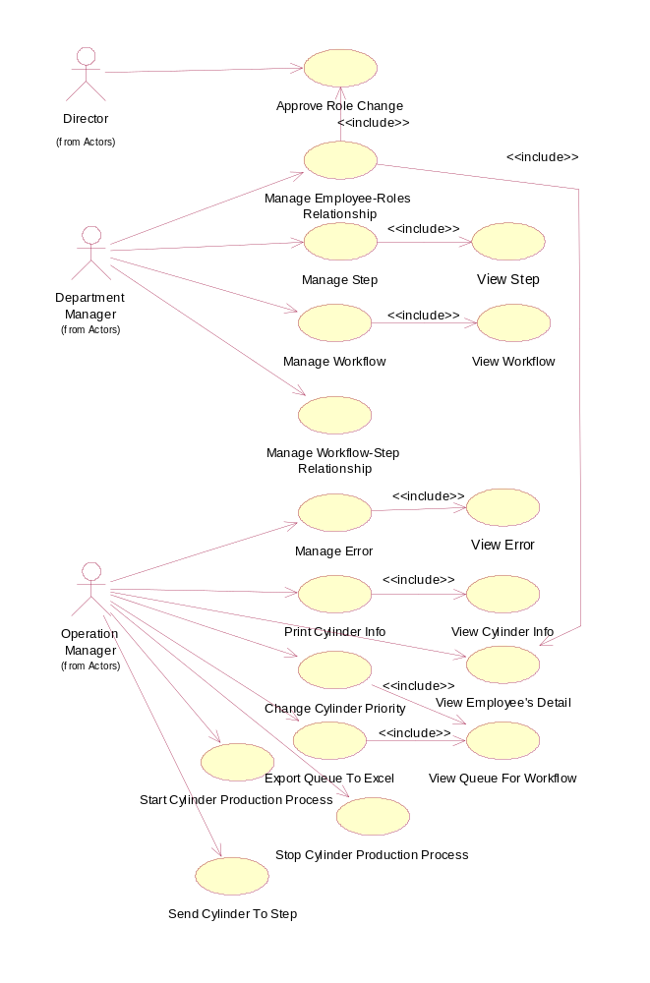
Use Case Modeling (3)

Slide 7
Use Case Analysis
Case 1: Update Cylinder Status
Case 2: Create Workflow

Slide 8
Software Architecture
a

Slide 9
Concept Prototype Demo
Prototype 1: web client
Prototype 2: thick client

Slide 10
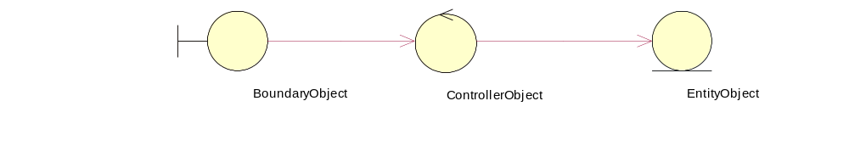
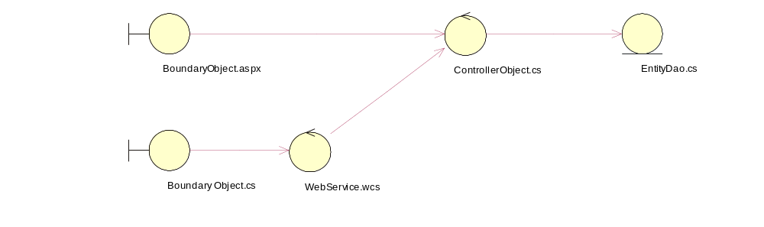
Transition Strategy

Slide 11
Overall Project Progress
Previous Phases 100%
Design Modeling Phase 30%
Programming Phase 4%

Slide 12
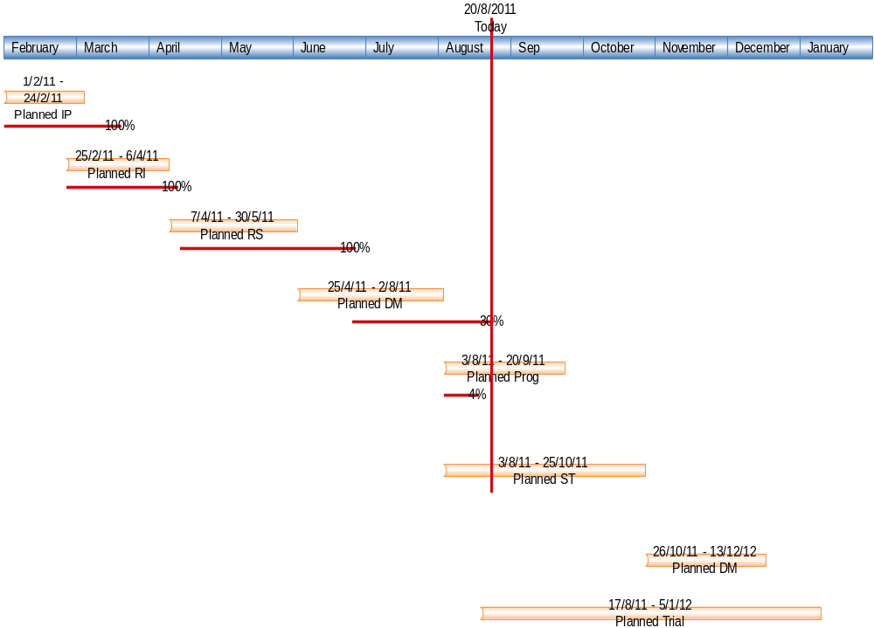

Slide 13
Management Problem
1 team member suffers from disease, can’t sleep at night, affecting work and project
2 team member are getting married in September and October
Team members are finding school work interfering with project work

Slide 14
Implementation Phase Plan
Schedule half a day on Sunday to work on project

Slide 15
Expected Implementation Issue

Slide 16
Q&A
Thank you

